Slide 1




Hello and welcome. We'll get started soon using Ms Teams
Please take a moment to familiarise yourself with the participant tools. These are located in a bar at the top of your screen.
Your video image. Please click on when you introduce yourself or want to speak.
Click to mute or unmute yourself. Please mute when not speaking to eliminate background noise.
Click to raise your hand if you have a question or comment etc. Then again to lower your hand when finished.
Click here to show the chat box on the right-hand side of your screen.
Click the telephone icon to leave the call at the end of the session.

Slide 2
DMC
Patient Participation Group Meeting
Chadwick Rd & Crystal Palace Rd
7th Sept 2022

Slide 3
Agenda
Welcome
Review of previous minutes
DMC - Patient Survey
Patient 'Go Digital'
Extended primary Care Service
Local Services
Freetalk
AOB – RCGP CQC

Slide 4
Survey
Appointment Feedback
Reason for the survey:
How can DMC make the process of accessing health care and patient interactions a positive experience?

Slide 5
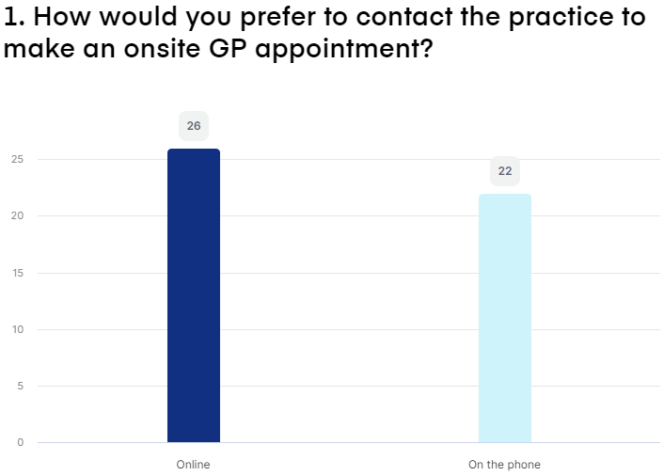
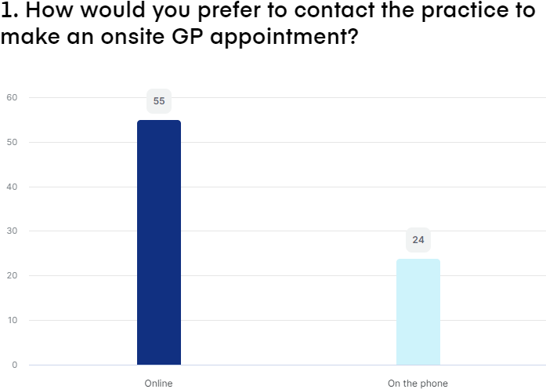
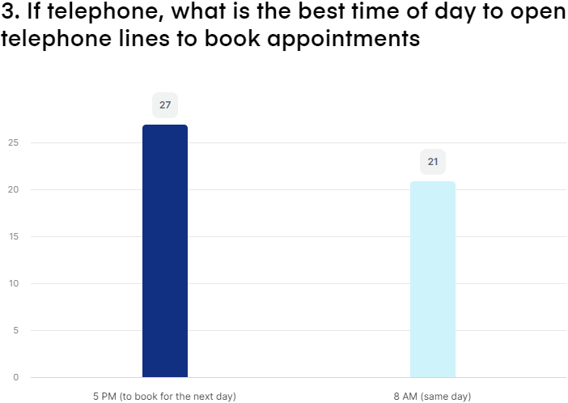
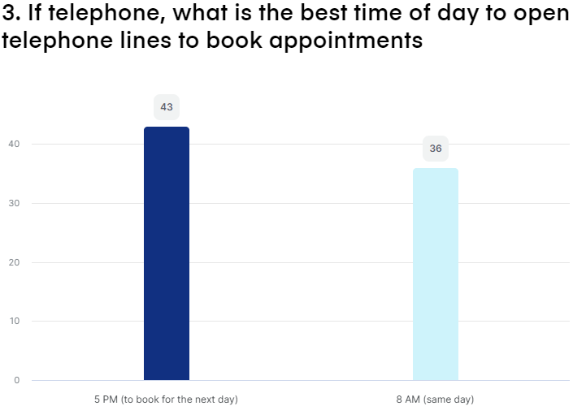
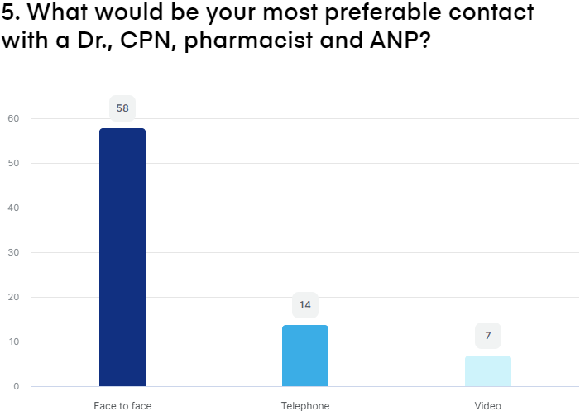
Group Age | CPR | CR
18-39Y

Slide 6
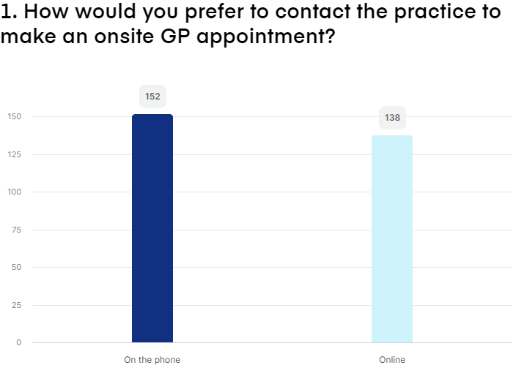
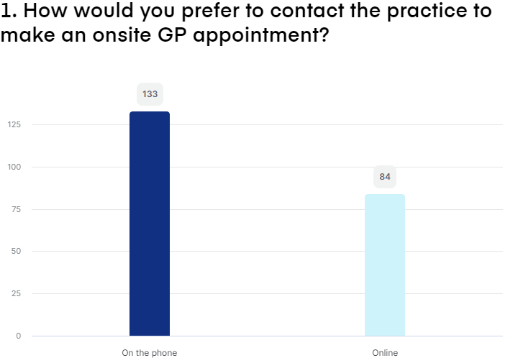
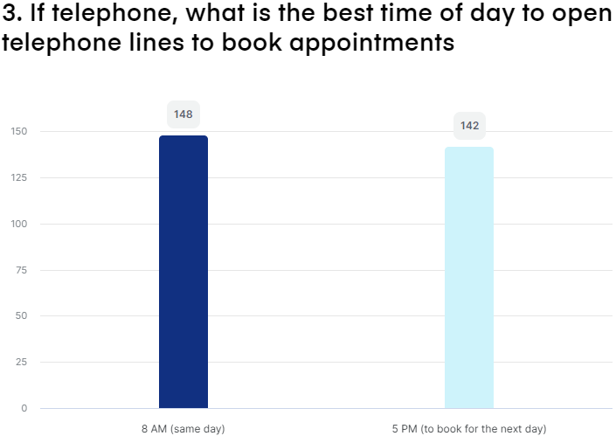
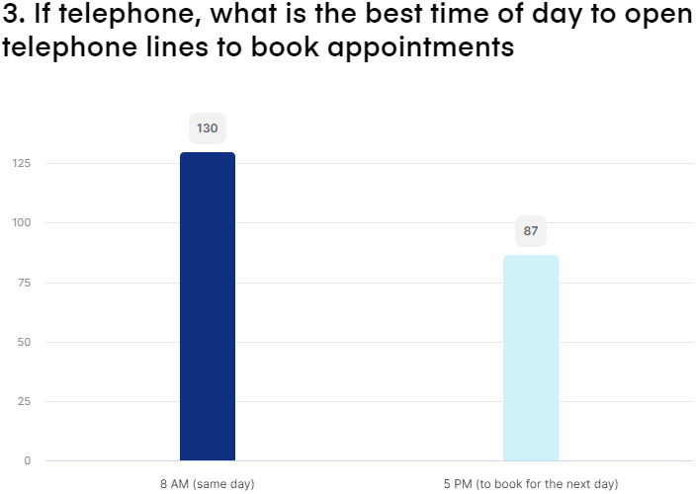
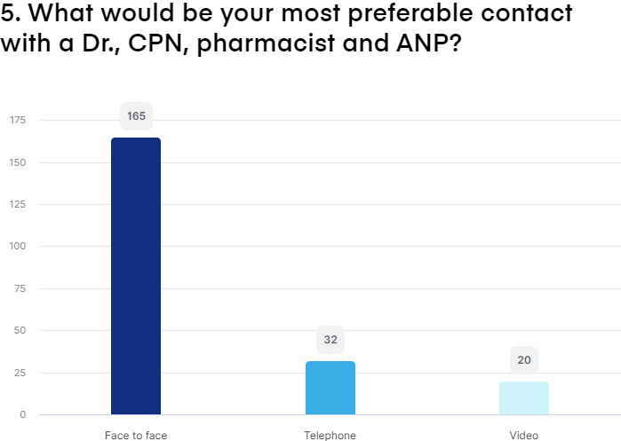
Group Age | CPR | CR
40-64Y

Slide 7
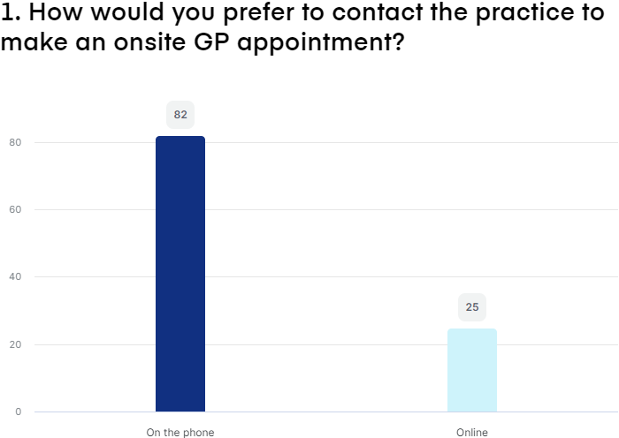
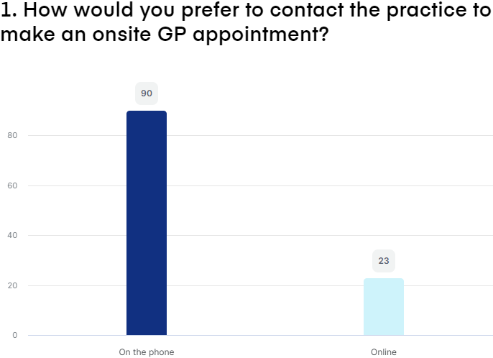

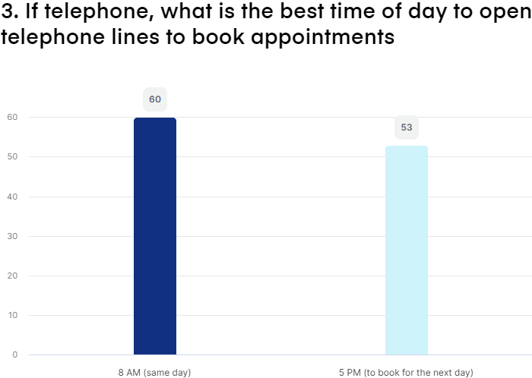

Group Age | CPR | CR
65+Y

Slide 8
What did we learn about appointments?
Preferred - Mode of consultation
80% of All cohorts wanted FTF appointments
Preferred - Time of appointment booking
55% of 18 to 39 wanted 5pm for next day appointments
50% of 40+ wanted 8am and 50% want 5pm
Preferred - Method to book appointment
70% of 18 to 39 wanted to book appointments online
80% of 65+ prefer to book appointments via telephone

Slide 9
Survey
Signposting & Education Feedback

Slide 10
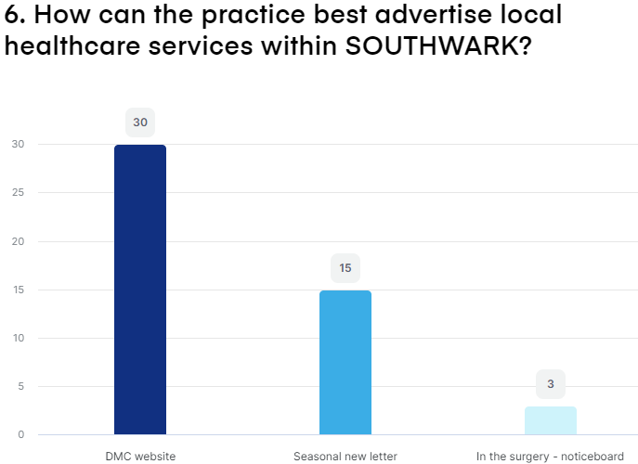
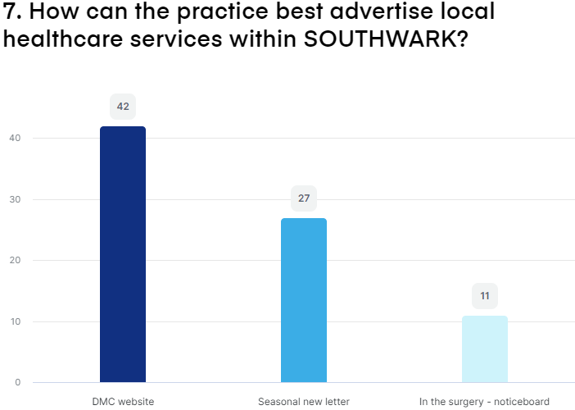
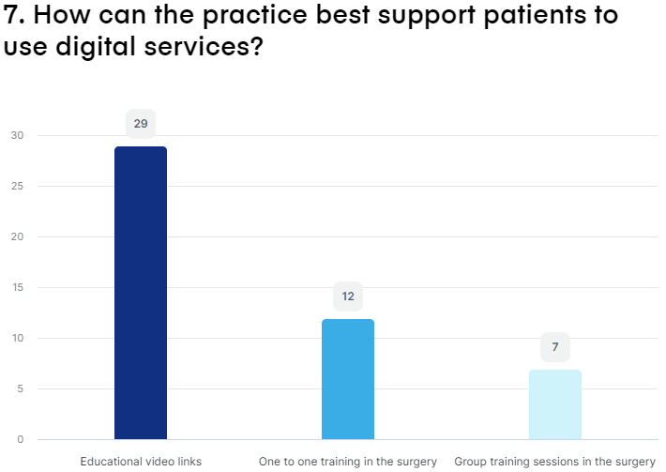
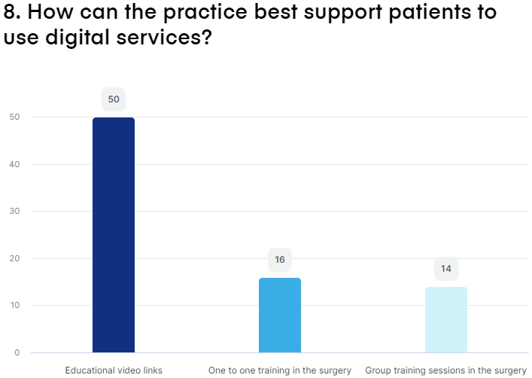
Group Age | CPR | CR
18-39Y

Slide 11
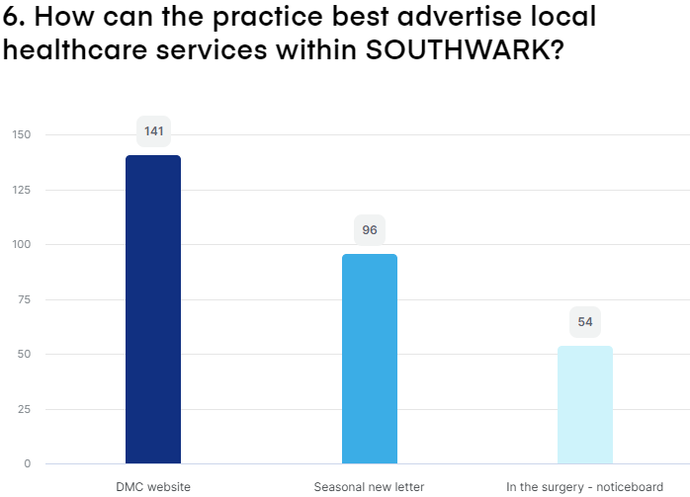
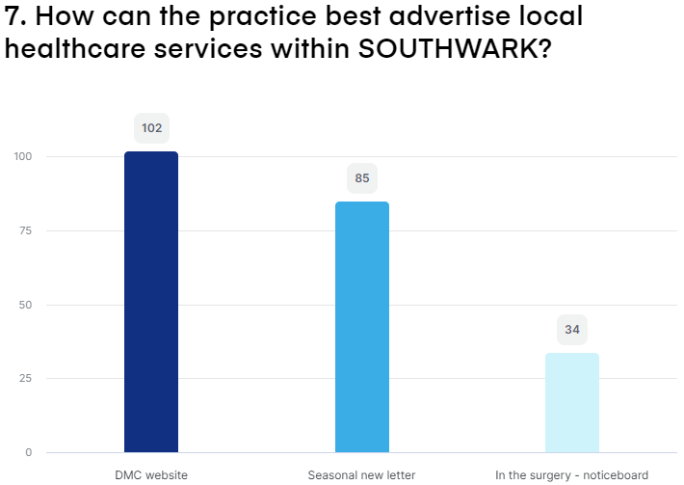
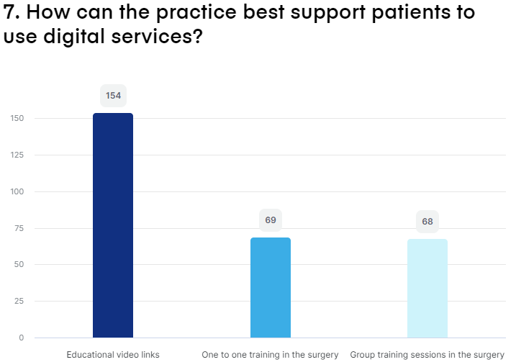
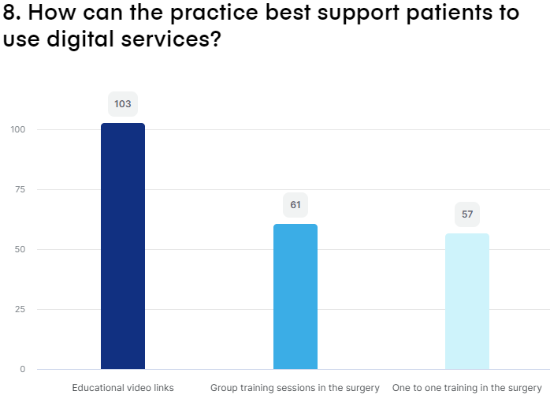
Group Age | CPR | CR
40-64Y

Slide 12
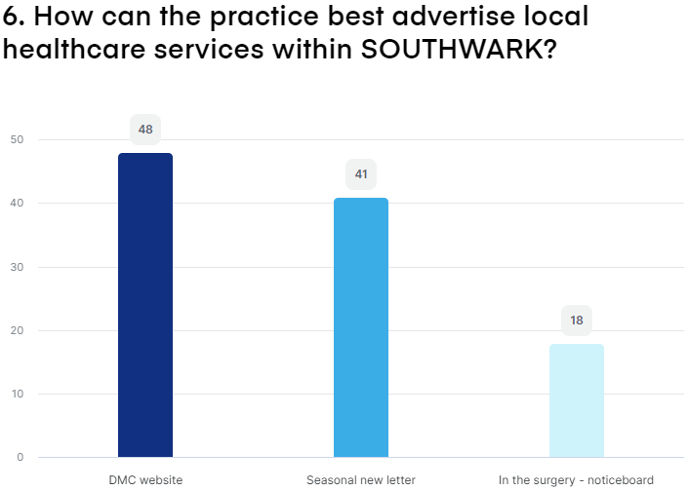
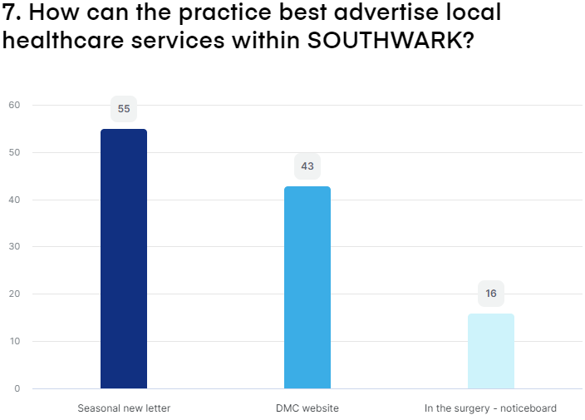
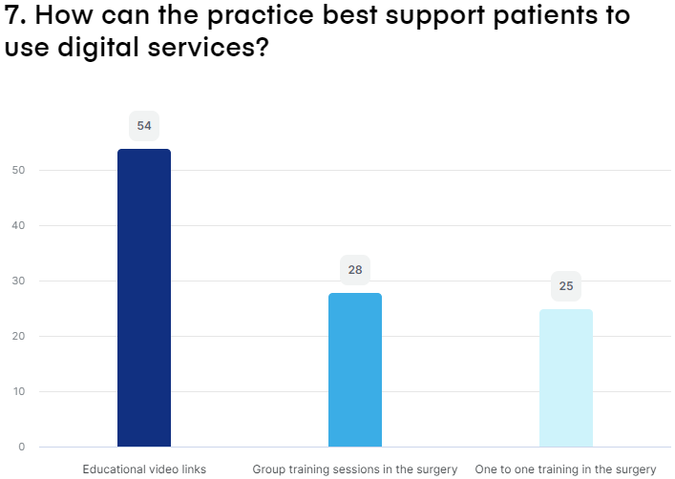
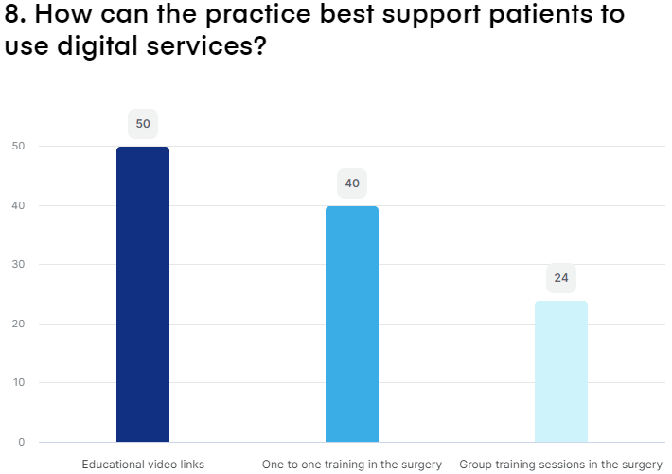
Group Age | CPR | CR
65+Y

Slide 13
What did we learn about Signposting and education?
Preferred - Method of signposting
Cohorts 18-64y prefer website signposting
Cohorts 65+ prefer newletter
Preferred - Education
Cohorts 18-64y prefer to be send educational videos
A high proportion of Cohorts 65+ are interested in one to one training

Slide 14
Survey Summary
Patients want!
More FTF appointments
BOTH 8am and 5pm booking times
More online appointments
Maybe, a distinction between onsite and offsite appointments
Better signposting via DMC website for Southwark healthcare services/ seasonal newsletter 65+y
All patients happy to receive educational links

Slide 15
Proposal with trade-off
Set up online appointments to allow patients to chooses their prefer mode of consultation: video, face to face and telephone
Create video content explaining eg.(how to) use e-consults?
Improve availability of online appt by removing pre-bookable?
Improve sigposting for local services on the website eg. Website Home page
Increase amount of face to face appointments - distinguish between on-site and off-site appointments? Open up appt at 2.30PM - 4.00PM for next day face to face appt. Create 2 lane to book appointments am and pm? Flatten demand

Slide 16
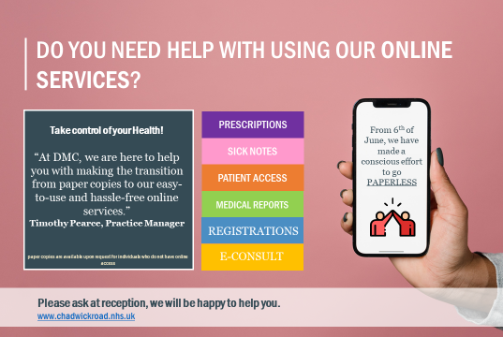
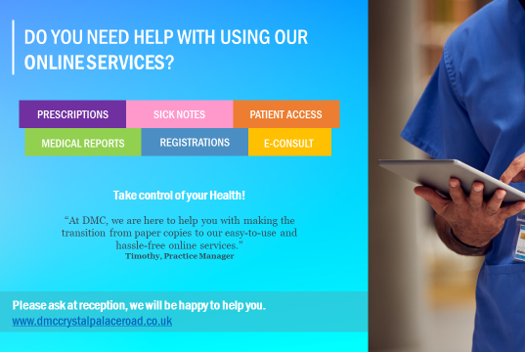
Patient Go Digital

Slide 17
Extended Primary care services
8am to 8pm hub (7 days a week) at Tessa Jowell / Lister Health centre
Appt with GP, Nurse and HCA

Slide 18
Local services
- Physio
-Audiology
-Mental Health
-Health and wellbeing coaching
-Social Prescriber

Slide 19
Patient Freetalk

Slide 20
AOB
DMC working with the RCGP to improve service started 6th Sept 2022

